Slide 1
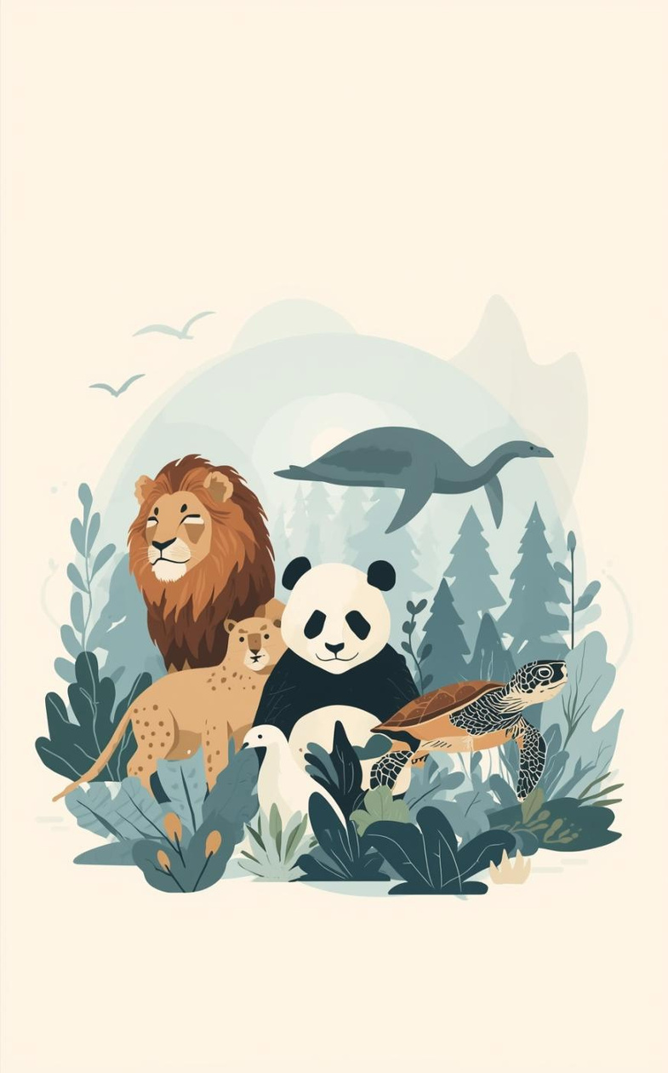

VOICES WITHOUT WORDS
Protecting Earth’s Silent Survivors
Presented by:
Keerthana
Sameera
Beulah Grace
Geetha
Pritha Mandaram

Slide 2

Human Population Growth
Impact on Wildlife Survival
Rapid human population growth and rising consumption are primary drivers of biodiversity loss, with wildlife populations plummeting by an average of 68-73% since 1970 due to habitat destruction, pollution, and climate change. Expanding human settlements and agricultural land use fragment natural habitats, bringing humans into direct conflict with species and threatening survival for numerous, specialized, and large-bodied animals.

Slide 3
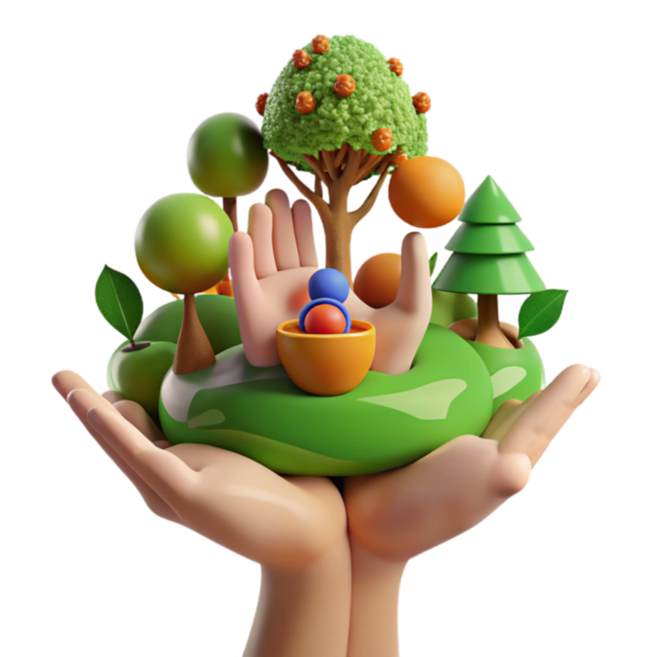
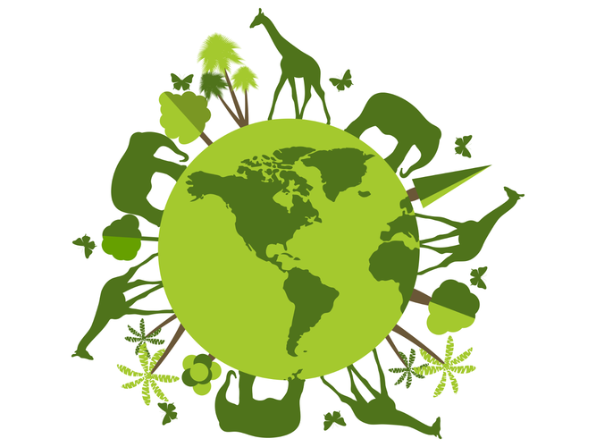
The Importance of Wildlife
Protecting Our Planet's Ecosystem
Every species is vital to maintaining ecological balance. By saving wildlife, we ensure the health of our environment, enhance biodiversity, and secure resources for future generations.
Wildlife is crucial for maintaining ecological balance, supporting biodiversity, and ensuring the health of the planet's ecosystems

Slide 4
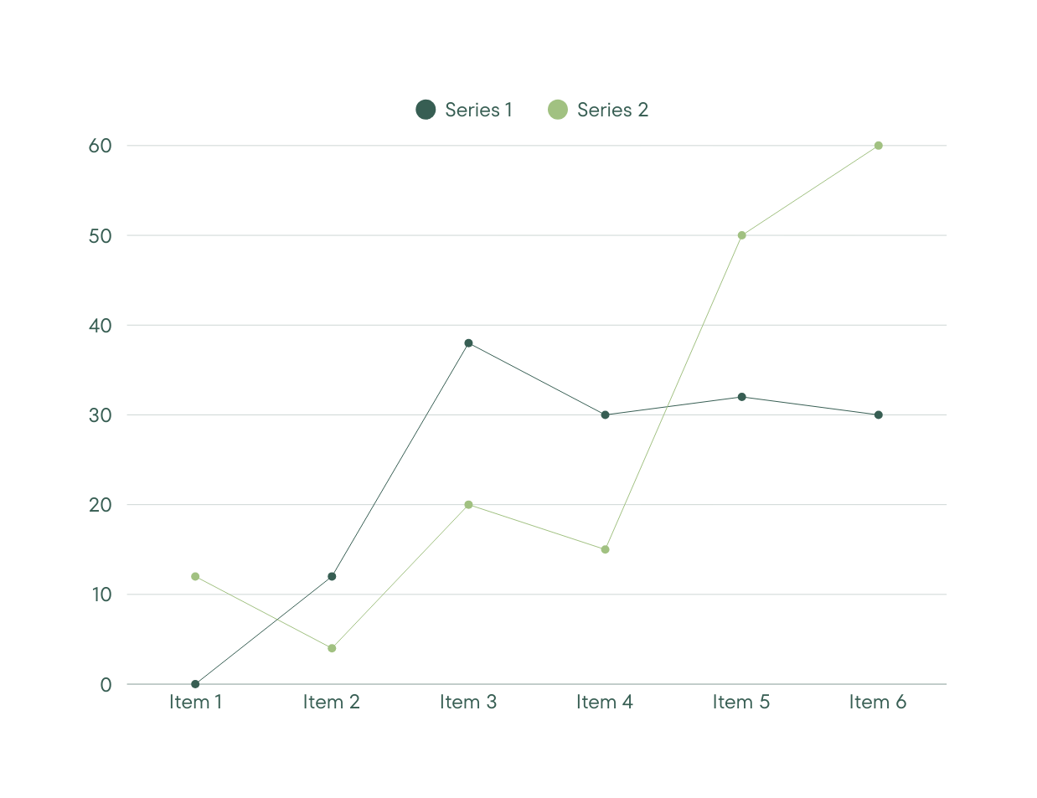
Extinction Life Cycle
Chart showing stages of animal extinction process
The impact of human activity on wildlife is devastating. Habitat loss leads to significant population decline, ultimately threatening biodiversity and disrupting ecosystems essential for our survival.

Slide 5
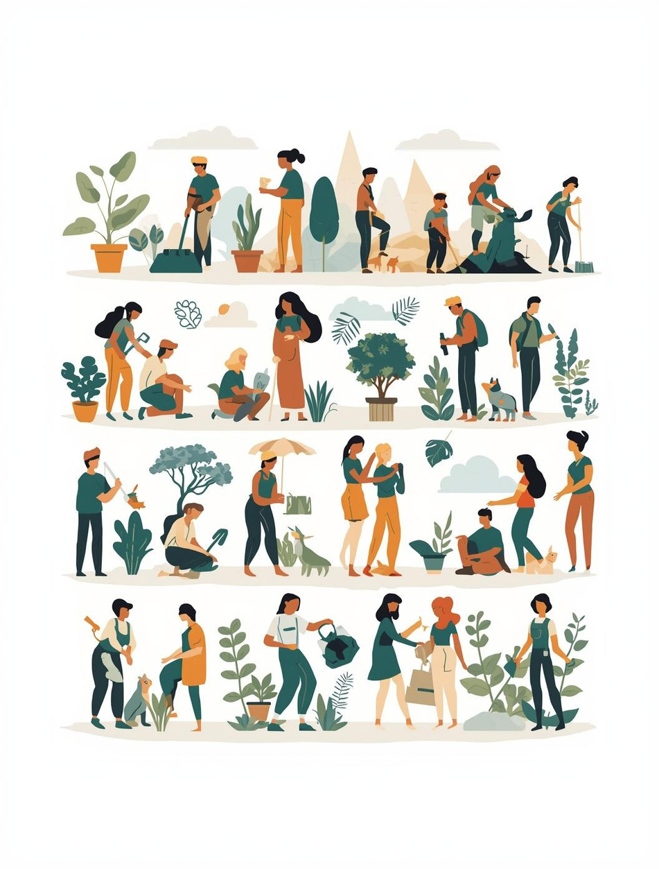
How can we help?
Simple actions can make a huge difference today.

Slide 6
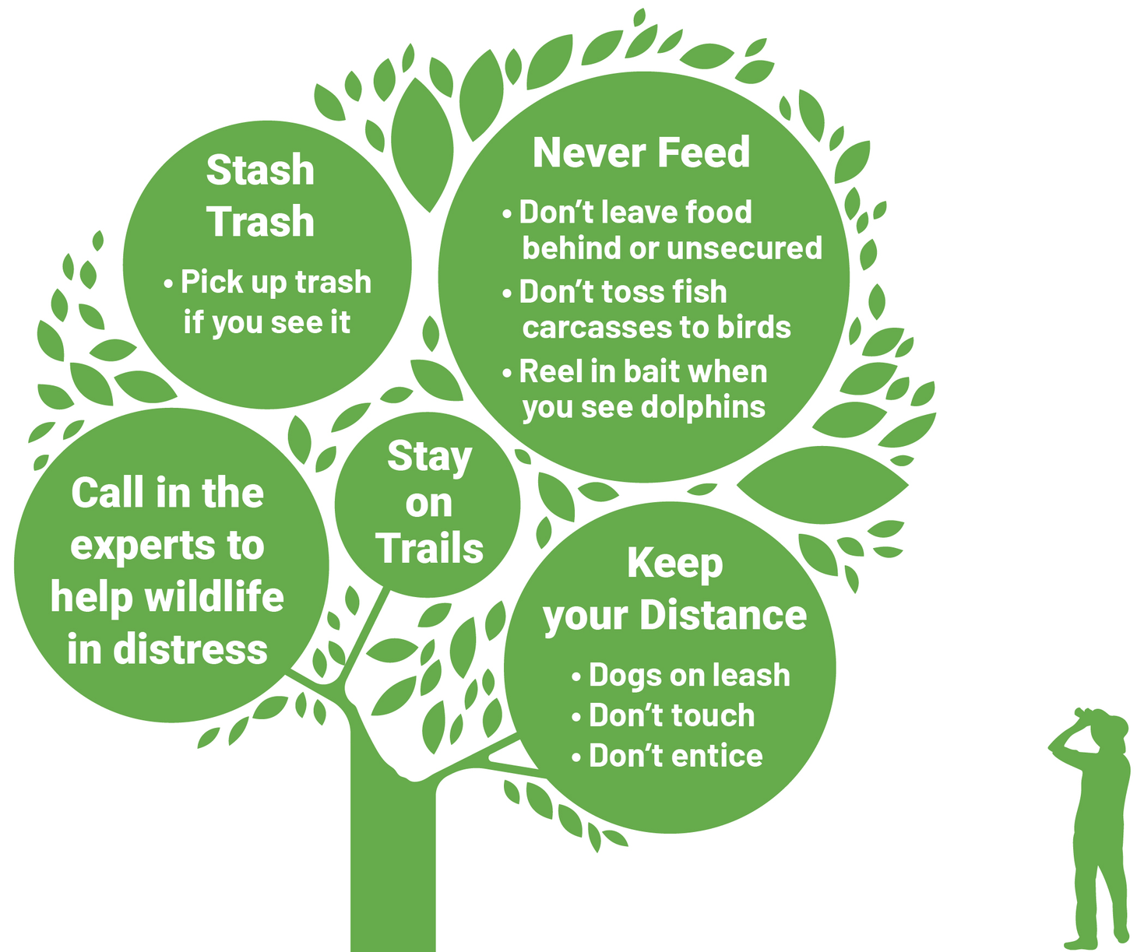
Saving wildlife can be achieved through simple, daily actions like reducing plastic use, planting native species, and protecting local habitats.

Slide 7
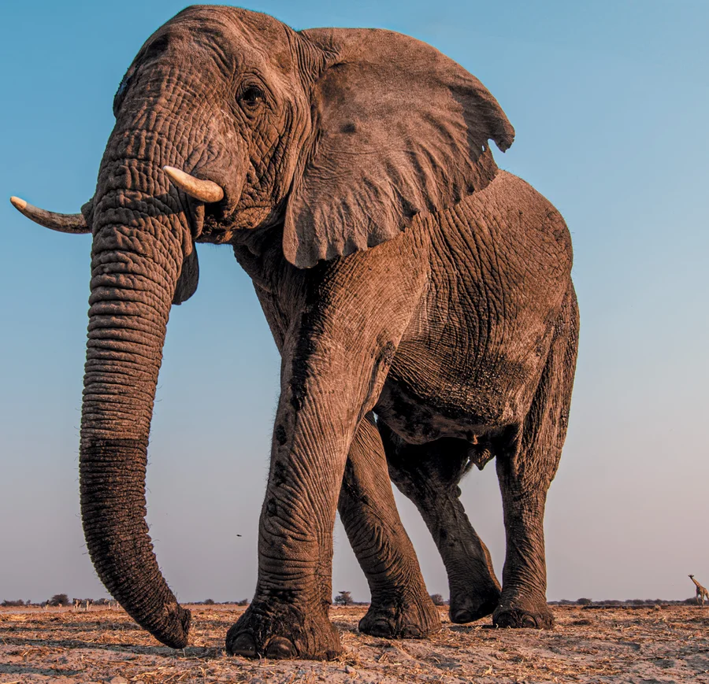
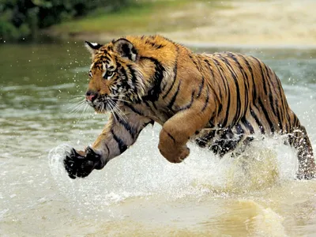

Slide 8
The choices we make today will determine the world future generations inherit. Let us be the generation that stood up, spoke out, and took action to preserve the beauty and diversity of life on Earth.
As the famous conservationist Jane Goodall once said:
*“What you do makes a difference, and you have to decide what kind of difference you want to make.”*

